Slide 1
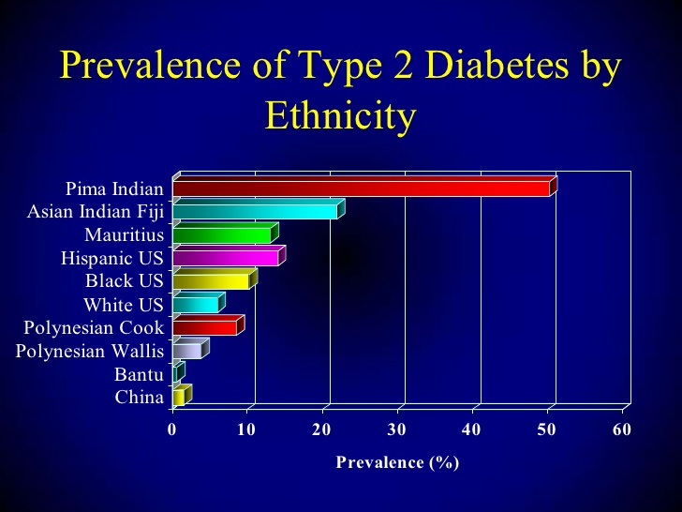
Data Analysis on PIMA Indian Diabetes Database
Group Members Megha Krishnamurthy Rakesh Harish Sakshi Shrivastava Suraj Gururaj Desai
Department of Computer Science
College of Computing and Informatics

Slide 2
Contents
The Dataset
Project Objective
Project Definition
Basic Data Exploration
Missing value treatment
Data Analysis
Observations
Data Assessment
Predictor Variables
Outliers treatment
Normalization
Data Partitioning and Evaluation
Data Modelling
Conclusion
Future Scope
Reference

Slide 3
The Dataset
PIMA Indians - group of Native Americans living in an area consisting of what is now central and southern Arizona.
A Snapshot of the information related to the diagnosis of all female patients in this area is represented in the dataset.
Predict whether the patient is diagnosed with diabetes based on diagnostic measurements available in the dataset
In particular, all patients here are females at least 21 years old of Pima Indian heritage.

Slide 4
The Dataset
Attributes Information:
1. Number of times pregnant
2. Plasma glucose concentration a 2 hours in an oral glucose tolerance test
3. Diastolic blood pressure (mm Hg)
4. Triceps skinfold thickness (mm)
5. 2-Hour serum insulin (mu U/ml)
6. Body mass index (weight in kg/(height in m)^2)
7. Diabetes pedigree function
8. Age (years)
9. Outcome - Class variable (0 or 1)

Slide 5
Project Objective
In this project, we center on applying data analysis techniques, create visualizations and interpret the models using histograms, scatter plots etc. to uncover the reason for high diabetic outcome amongst the PIMA Indian women.
Predict whether the patient is diagnosed with diabetes based on diagnostic measurements available in the dataset
We also break down the relationships between different aspects of the chosen data and find the correlations to help understand the end outcome.

Slide 6
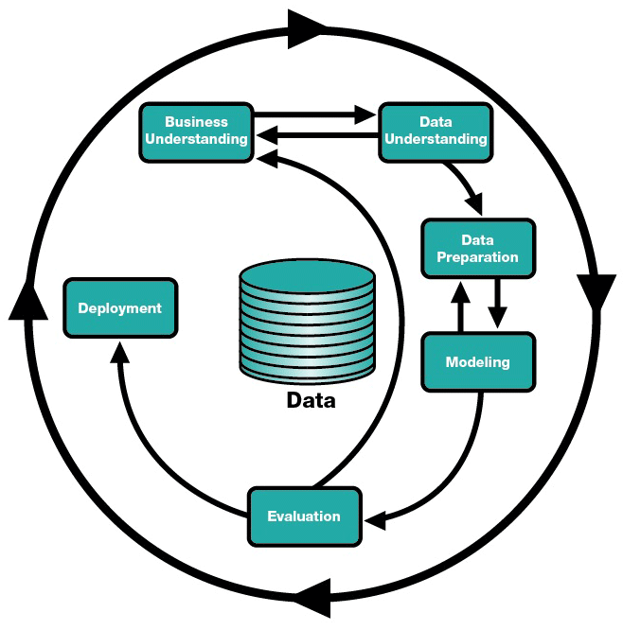
Project Cycle

Slide 7
Project Definition
Definition
To establish a relationship between parameters such as number of pregnancies, BMI, age etc., and diabetic diagnosis of the patients based on these factors.
Requirement
A comprehensive understanding of the parameters in relation
with the diabetes presented in the database.

Slide 8
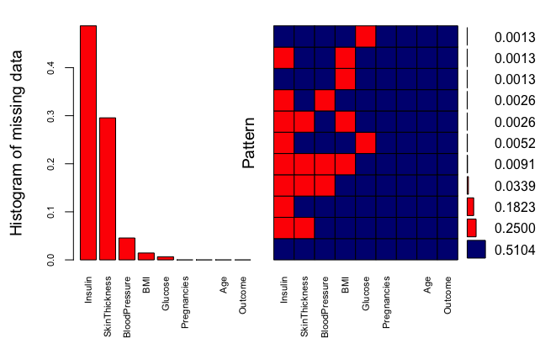
Basic Data Exploration
The graph represents missing value proportions for each combination of attributes
Red depicts missing values, where as blue depicts valid data

Slide 9
Missing value treatment
392 records were found to have a zero value for different attributes.
MICE has been used with “norm.predict” method.
We tried using few MICE methods such as pmm, mean, norm. However, norm.predit gave us a very good imputation of missing data.

Slide 10
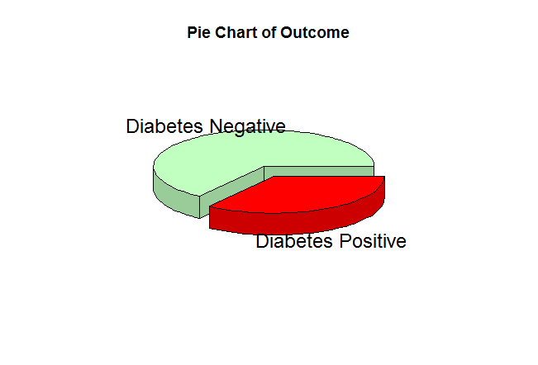
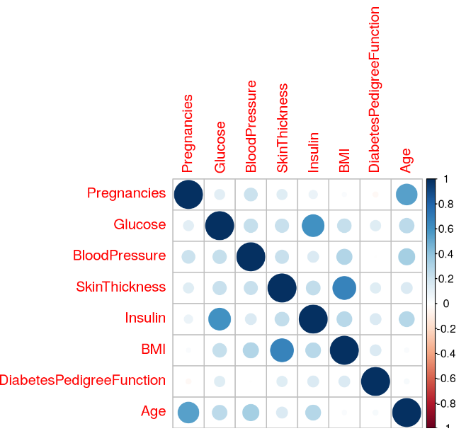
Data Analysis
The Pie Chart represents the ratio of diabetic vs non diabetic PIMA females in the given data
65.15%
34.85%
This graph represents the
correlation across all attributes
SkinThickness~BMI and
Insulin~Glucose were found to
have a strong correlation

Slide 11
Observations
 |  | Glucose
 |  | < 140 | >= 140 | Total
Diabetic? | False | 438 (87.6%) | 62 (12.4%) | 500
 | True | 133 (49.6%) | 135 (50.37%) | 268
 | Total | 571 | 197 | 768
 |  | Pregnancies
 |  | < 5 | >=5 | Total
Diabetic? | False | 356(72%) | 144(52%) | 500
 | True | 136(27%) | 132(50%) | 268
 | Total | 492 | 276(35) | 768
Table for Diabetic patients with Glucose < 140 |  | BMI and Skin Thickness
 |  | < 26 & < 23 | > 26 & > 23 | Total
Diabetic? | True | 24(10%) | 119(90%) | 133
 |  | BMI
 |  | <= 25 | >25 | Total
Diabetic? | False | 105(94%) | 395(60%) | 500
 | True | 7(6%) | 261(99%) | 268
 | Total | 112 | 656(84) | 768

Slide 12
Data Assessment
Although Insulin is a predictor variable towards the outcome, since most of its values is imputed it is not considered for further analysis in this phase
Although Age is not a strong predictor, we are considering an equal width binning for our analysis
Glucose is the strongest contributor for our analysis; and we have categorized it as a flag variable

Slide 13
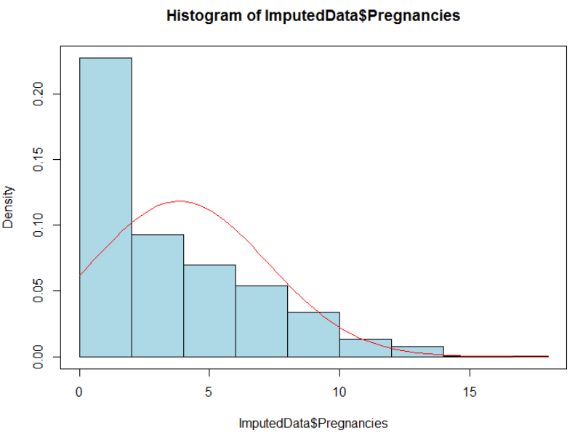
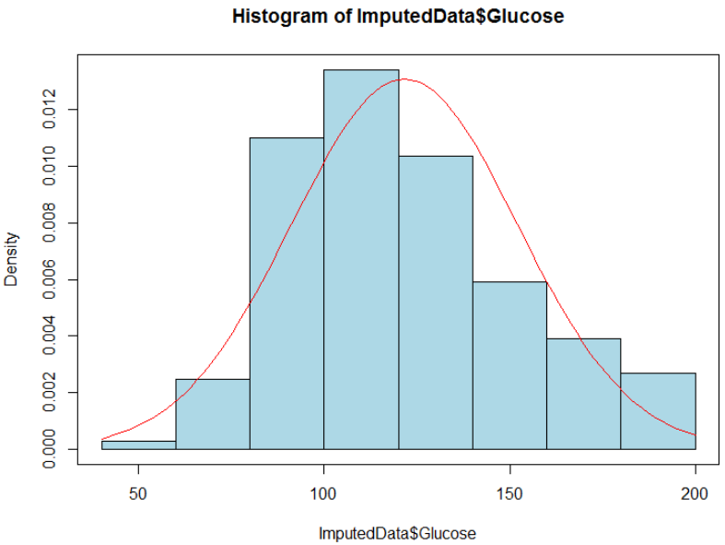
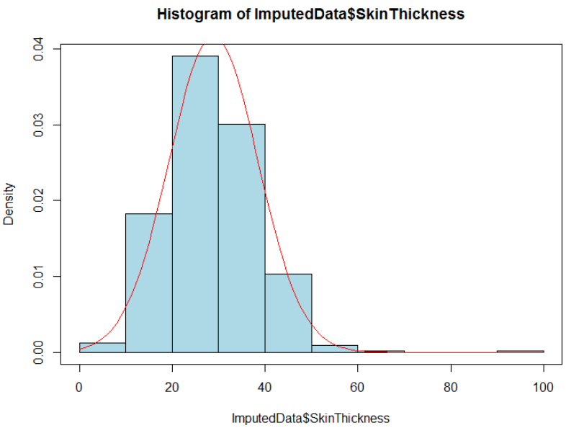
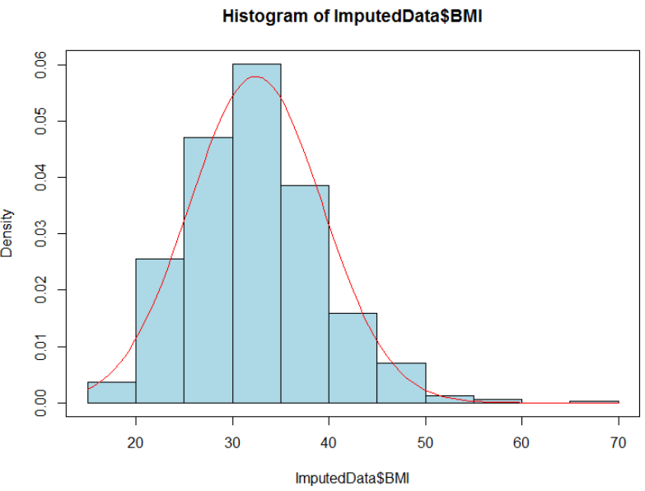
Predictor
Variables
Below graphs represent Histograms for four predictor variables before Transformation, i.e., Pregnancies, Glucose, Skin Thickness and BMI respectively.

Slide 14
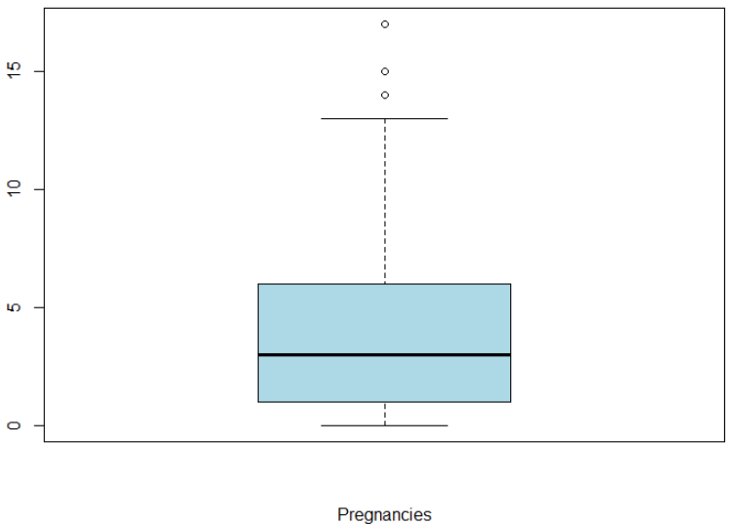
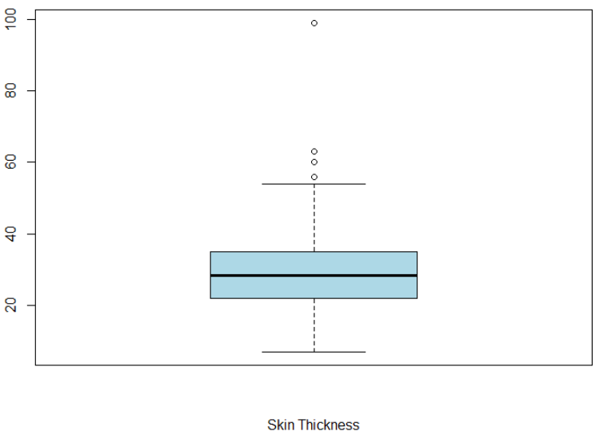
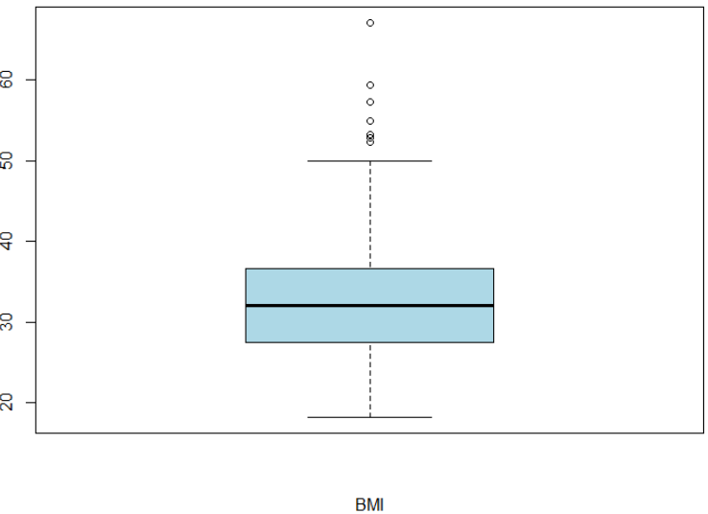
Outlier Detection
Our Outlier detection and removal focuses only on the four strong predictor variables
We found that Glucose does not have any Outliers, we checked and removed for the Outliers in the other three variables

Slide 15
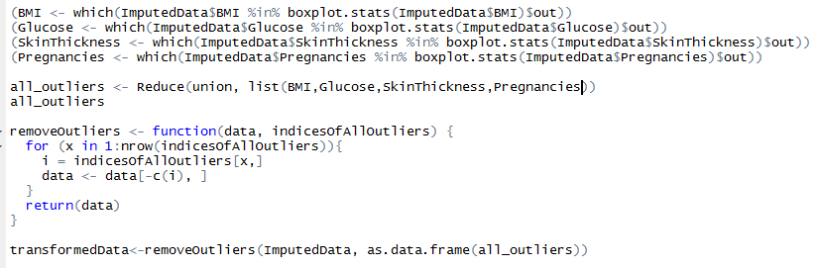
Outlier Removal

Slide 16
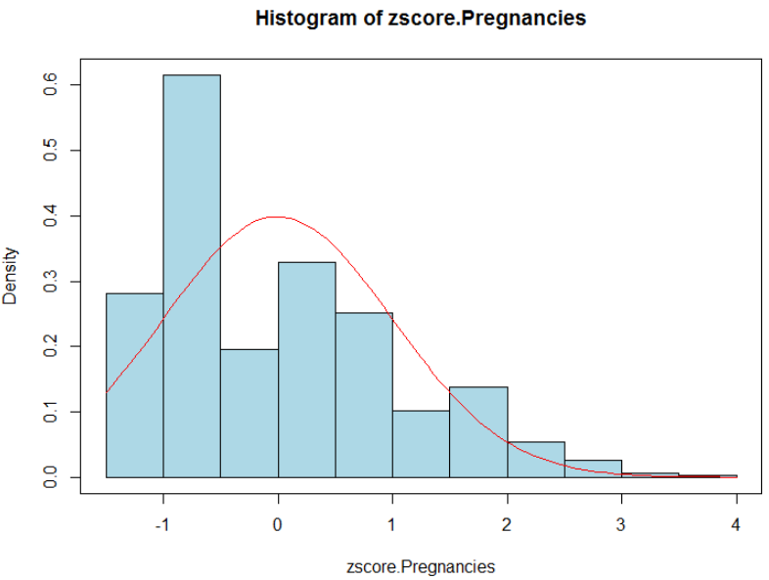
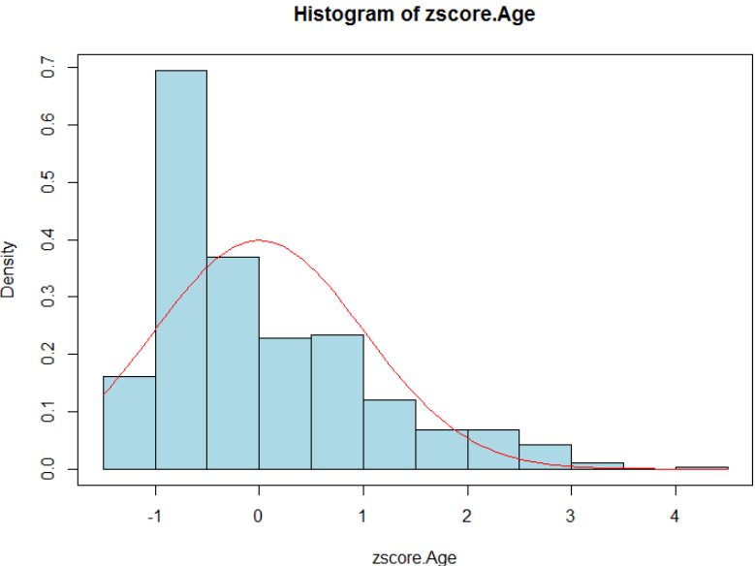
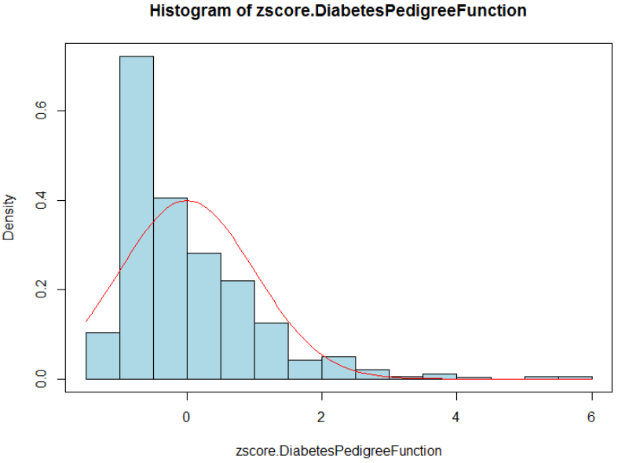
Normalization
The following three variables were not in normalized form
Pregnancies, Age, Diabetes Pedigree Function
Hence we employed Z-Score Transformation on these variables
Below graphs represent Z-Score Transformed histograms for the above variables

Slide 17
Data
Partitioning and Evaluation
The Dataset was split into Train and test with the Sample.Split function provided in the caTools library. Split Ratio of 70% was employed.
Below t-test was performed on the partitions to validate the partitioning;
T-test for Glucose : p-value – 0.57
T-test for SkinThickness: p-value - 0.41
T-test for BMI: p-value – 0.89
T-test for Pregnancies: p-value – 0.16
Based on the results above we conclude the
partition is valid.

Slide 18
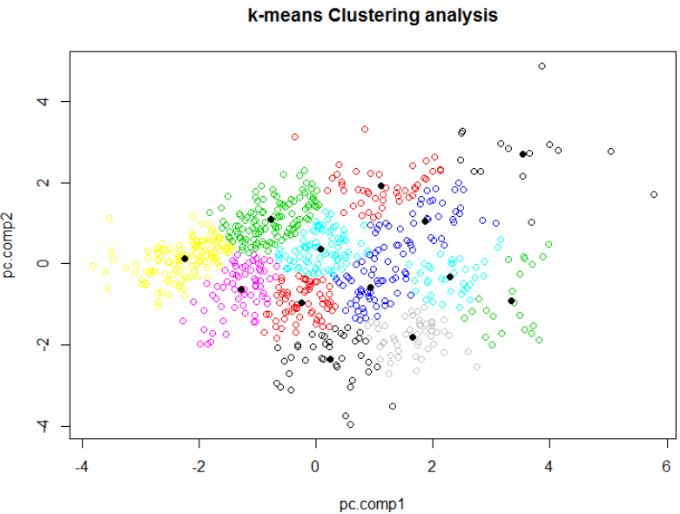
Data Modeling
Unsupervised Learning Method
K-means Clustering
Cluster data based on their similarity.
OUTCOME column removed for this technique; and the algorithm just tries to find patterns in the data.
For the convenience of visualization, we have taken the first two principle components as the new feature variables and conduct k-means only on these two dimensional data.
Figure shows the resulting scatter plot with different clusters in different colors. The solid black circles are the centers of the clusters.

Slide 19
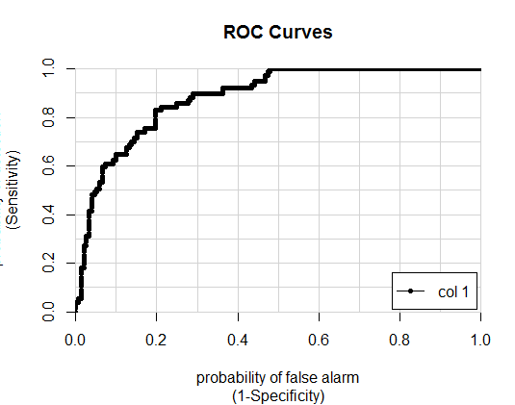
Data Modeling
(Contd..)
Supervised Learning Method
Logistic Regression
Result from Logistic Regression
AUC = 0.835292 (not bad)
# Accuracy : 0.7719
# 95% CI : (0.7119, 0.8247)
# No Information Rate : 0.6842
# P-Value [Acc > NIR] : 0.00219
# Kappa : 0.4431
# Mcnemar's Test P-Value : 0.07142
# Sensitivity : 0.5417
# Specificity : 0.8782
# Pos Pred Value : 0.6724
# Neg Pred Value : 0.8059
# Prevalence : 0.3158
# Detection Rate : 0.1711
# Detection Prevalence : 0.2544
# Balanced Accuracy : 0.7099
# 'Positive' Class : X1

Slide 20
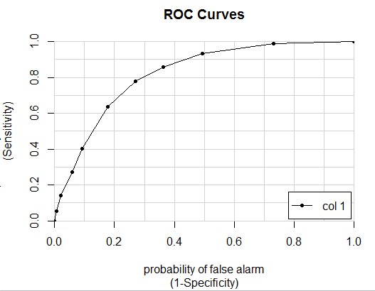
Data Modeling
(Contd..)
k-Nearest Neighbor
Result from k-Nearest Neighbor
# Accuracy : 0.7193
# 95% CI : (0.6562, 0.7766)
# No Information Rate : 0.6842
# P-Value [Acc > NIR] : 0.1423
# Kappa : 0.3693
# Mcnemar's Test P-Value : 0.3816
# Sensitivity : 0.6111
# Specificity : 0.7692
# Pos Pred Value : 0.5500
# Neg Pred Value : 0.8108
# Prevalence : 0.3158
# Detection Rate : 0.1930
# Detection Prevalence : 0.3509
# Balanced Accuracy : 0.6902
# 'Positive' Class : X1

Slide 21
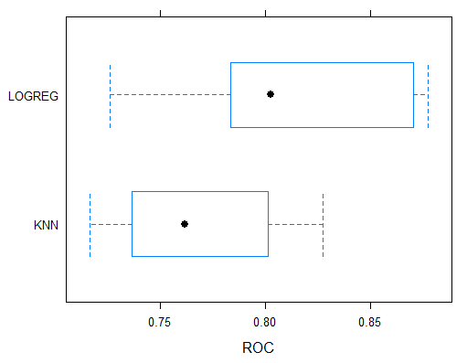
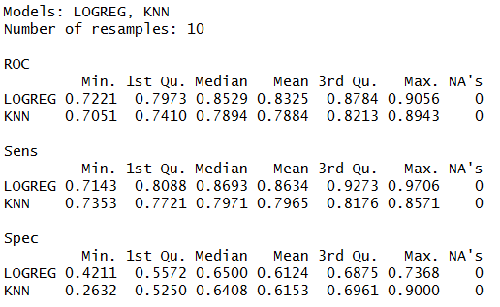
Data Modeling
(Contd..)
Models Comparison

Slide 22
Data Modeling
(Contd..)
Association(Using “aPriori” algorithm)
{Age=[21.0,32.5), Outcome=1} => {Pregnancies=[ 0.00, 4.19)}
{Glucose=[150,199], BMI=[29.2,38.0)} => {Outcome=1}
{Glucose=[ 44,112), Outcome=1} => {Insulin=[-20.8,158.7)}
{Glucose=[150,199], DPF=[0.476,1.030)} => {Outcome=1}
{Pregnancies=[ 4.19, 9.02), DPF=[1.030,2.420]} => {Outcome=1}
{Insulin=[365.2,846.0], Age=[48.5,81.0]} => {Outcome=1}

Slide 23
Conclusion
We have developed four models. It gives us the results of prediction and accuracy – shows which are the most important factors to have diabetes.
Higher the number of pregnancies count, higher the probability of getting the diabetes.
As per the observations, as a person reaches a near diabetic phase, it is found that BMI and ST increase in tandem. This leads to insulin resistance

Slide 24
Future Scope
If we get and correlate the cardiac history of the patients we can build a better model with better accuracy
With a better Insulin records, we can build a much better model
Try to build different machine learning models and possibly have a stacked one

Slide 25
References
https://en.wikipedia.org/wiki/Pima_people
http://www.srpmic-nsn.gov/history_culture/
http://care.diabetesjournals.org/content/29/8/1866
https://www.kaggle.com/uciml/pima-indians-diabetes-database
https://rpubs.com/ikodesh/53189
https://www.youtube.com/watch?v=pN4HqWRybwk
http://www.diabetes.co.uk/diabetes_care/blood-sugar-level-ranges.html
http://machinelearningmastery.com/
https://www.r-bloggers.com/self-organising-maps-for-customer-segmentation-using-r/
https://onlinecourses.science.psu.edu/stat857/node/125
Department of Computer Science
College of Computing and Informatics

